Slide 1

INSTITUTE : UIE
DEPARTMENT : CSE
Bachelor of Engineering (Computer Science & Engineering)
PROJECT BASED LEARNING IN JAVA
(CST-358/ITT-358)
TOPIC OF PRESENTATION:
JSP include tag, JSP page tag (CO 5)
DISCOVER . LEARN . EMPOWER

Slide 2

Lecture Objectives
In this lecture, we will discuss:
JSP include tag, JSP page tag

Slide 3
jsp:include action tag
The jsp:include action tag is used to include the content of another resource it may be jsp, html or servlet.
The jsp include action tag includes the resource at request time so it is better for dynamic pages because there might be changes in future.
The jsp:include tag can be used to include static as well as dynamic pages.
Advantage of jsp:include action tag
Code reusability : We can use a page many times such as including header and footer pages in all pages. So it saves a lot of time.

Slide 4
Difference between jsp include directive and include action
JSP include directive | JSP include action
includes resource at translation time. | includes resource at request time.
better for static pages. | better for dynamic pages.
includes the original content in the generated servlet. | calls the include method.

Slide 5
Difference between jsp include directive and include action
Syntax of jsp:include action tag without parameter
<jsp:include page="relativeURL | <%= expression %>" />
Syntax of jsp:include action tag with parameter
<jsp:include page="relativeURL | <%= expression %>">
<jsp:param name="parametername" value="parametervalue | <%=expression%>" />
</jsp:include>

Slide 6
Example of jsp:include action tag without parameter
In this example, index.jsp file includes the content of the printdate.jsp file.
File: index.jsp
<h2>this is index page</h2>
<jsp:include page="printdate.jsp" />
<h2>end section of index page</h2>
File: printdate.jsp
<% out.print("Today is:"+java.util.Calendar.getInstance().getTime()); %>

Slide 7
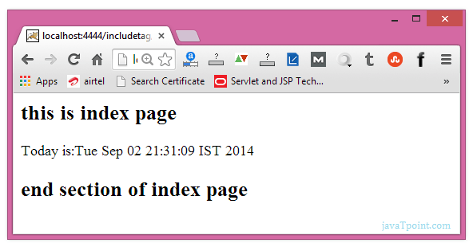

Slide 8
JSP page directive
The page directive defines attributes that apply to an entire JSP page.
Syntax of JSP page directive
<%@ page attribute="value" %>
Attributes of JSP page directive
import
contentType
buffer
language
isELIgnored
pageEncoding
errorPage
isErrorPage

Slide 9
1)import
The import attribute is used to import class,interface or all the members of a package.It is similar to import keyword in java class or interface.
Example of import attribute
<html>
<body>
<%@ page import="java.util.Date" %>
Today is: <%= new Date() %>
</body>
</html>

Slide 10
2)contentType
The contentType attribute defines the MIME(Multipurpose Internet Mail Extension) type of the HTTP response.The default value is "text/html;charset=ISO-8859-1".
Example of contentType attribute
<html>
<body>
<%@ page contentType=application/msword %>
Today is: <%= new java.util.Date() %>
</body>
</html>

Slide 11
3)extends
The extends attribute defines the parent class that will be inherited by the generated servlet.It is rarely used.
4)info
This attribute simply sets the information of the JSP page which is retrieved later by using getServletInfo() method of Servlet interface.
Example of info attribute
<html>
<body>
<%@ page info="composed by Sonoo Jaiswal" %>
Today is: <%= new java.util.Date() %>
</body>
</html>
The web container will create a method getServletInfo() in the resulting servlet.For example:
public String getServletInfo() {
return "composed by Sonoo Jaiswal";
}

Slide 12
5)buffer
The buffer attribute sets the buffer size in kilobytes to handle output generated by the JSP page.The default size of the buffer is 8Kb.
Example of buffer attribute
<html>
<body>
<%@ page buffer="16kb" %>
Today is: <%= new java.util.Date() %>
</body>
</html>
6)language
The language attribute specifies the scripting language used in the JSP page. The default value is "java".

Slide 13
7)isELIgnored
We can ignore the Expression Language (EL) in jsp by the isELIgnored attribute. By default its value is false i.e. Expression Language is enabled by default. We see Expression Language later.
<%@ page isELIgnored="true" %>//Now EL will be ignored
8)isThreadSafe
Servlet and JSP both are multithreaded.If you want to control this behaviour of JSP page, you can use isThreadSafe attribute of page directive.The value of isThreadSafe value is true.If you make it false, the web container will serialize the multiple requests, i.e. it will wait until the JSP finishes responding to a request before passing another request to it.If you make the value of isThreadSafe attribute like:<%@ page isThreadSafe="false" %>
The web container in such a case, will generate the servlet as:
public class SimplePage_jsp extends HttpJspBase
implements SingleThreadModel{
.......
}

Slide 14
9)errorPage
The errorPage attribute is used to define the error page, if exception occurs in the current page, it will be redirected to the error page.
Example of errorPage attribute
//index.jsp
<html>
<body>
<%@ page errorPage="myerrorpage.jsp" %>
<%= 100/0 %>
</body>
</html>

Slide 15
10)isErrorPage
The isErrorPage attribute is used to declare that the current page is the error page.
Note: The exception object can only be used in the error page.
Example of isErrorPage attribute
//myerrorpage.jsp
<html>
<body>
<%@ page isErrorPage="true" %>
Sorry an exception occured!<br/>
The exception is: <%= exception %>
</body>
</html>

Slide 16
Summary:
In this session, you were able to :
• JSP include tag, JSP page tag

Slide 17
References:
Books:
1. Balaguruswamy, Java.
2. A Primer, E.Balaguruswamy, Programming with Java, Tata McGraw Hill Companies
3. John P. Flynt Thomson, Java Programming.
Video Lectures :
https://youtu.be/f1Qa7mg2tFE
Reference Links:
https://www.javatpoint.com/jsp-page-directive
https://www.javatpoint.com/jsp-tutorial
https://www.javatpoint.com/jsp-include-action
https://beginnersbook.com/2013/11/jsp-include-action-tag/
https://www.codejava.net/java-ee/jsp/jsp-include-standard-action-examples

